Slide 1

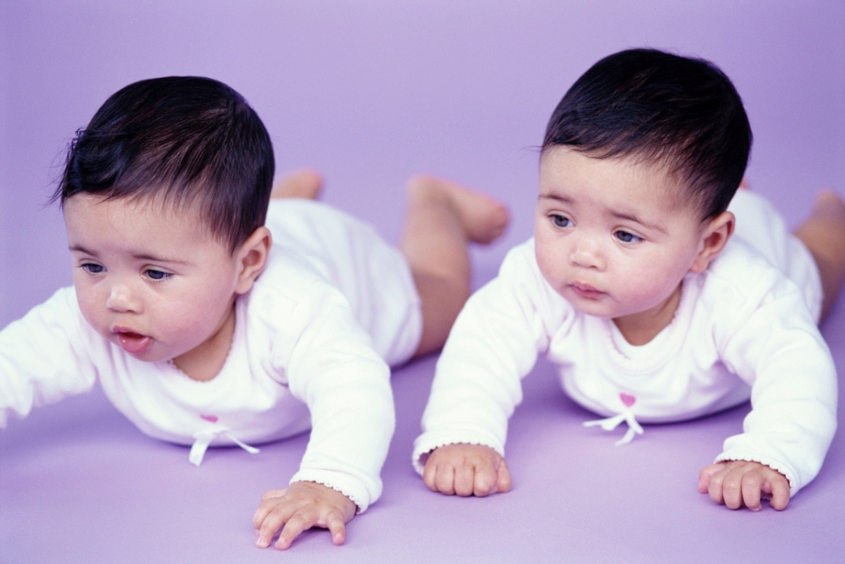
“Blood Brothers”
Mrs Lyons
Character Study

Slide 2
Learning Goals
We are learning to:-
Have a deeper understanding of Mrs Lyons and in turn Mrs Johnstone;
Express our opinion and support with appropriate evidence from the text;
Work in pairs; sharing thoughts, ideas and opinions;
Record our responses in a range of forms.

Slide 3

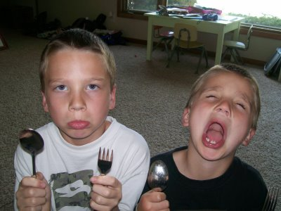
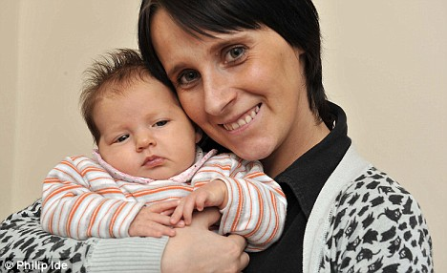
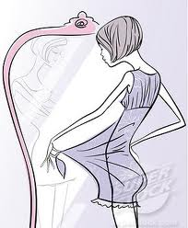
How do these images remind you of the play?

Slide 4


Adjectives to describe Mrs Lyons
Cruel
Calculating
Cold
Evil
Cunning
Selfish
Desperate
Agitated
Jealous

Slide 5

Adjectives Task (10 minutes)
In pairs discuss a range of additional adjectives to describe Mrs Lyons.
Choose SIX and record these in a spider-diagram.

Slide 6
Mrs Lyons Character Study
A large part of the tension throughout the play hangs on the superstition that Mrs Lyons uses to trap Mrs Johnstone into silence; that should Mickey and Eddie discover their brotherhood, they will both die.
Throughout the play we see the huge contrast between Mrs Lyons and Mrs Johnstone.
Why do you think the narrator refers to Mrs Johnstone as the “Mother so cruel” at the start of the play?
Do you agree? Why/ Why not?
(discuss in pairs)

Slide 7
Discussion Activities
Rather than viewing Mrs Johnstone as a cruel character do you sympathise with her dilemma?
Remember we know she struggles with a house full of children.
She has endless patience and tenderness.
She is trapped by her social position and her lack of funds.
She is down-to-earth and does not see money as the answer to all of her problems. (We see her refuse money from the desperate Mrs Lyons)

Slide 8

Mrs Lyons
MRS LYONS: Thousands… I’m talking about thousands if you want it, and think what you could do with money like that.
MRS JOHNSTONE: I’d spend it. I’d buy more junk and trash; that’s all. I don’t want your money. I’ve made a life here. It’s not much of one maybe, but I made it.
What does this quotation tell you about Mrs Lyons?
What does this quotation tell you about Mrs Johnstone?

Slide 9

Did you mention?
Mrs Lyons is very conscious of her social position and this scene indicates that she sees money as a solution to the problems of Mrs Johnstone.
Mrs Lyons is also portrayed as a cold woman who doesn’t show much emotion. She is very over-protective of Eddie and fears his bond with the Johnstones.

Slide 10


What did you learn today?
Look at your learning goals.
Did you achieve these?
Give reasons for your response.

